Slide 1
CSE101-Lec#28-29
Dynamic memory management

Slide 2
Outline
Dynamic Memory management
  malloc()
  calloc()
  realloc()
  free()

Slide 3


Slide 4
Dynamic Memory Allocation
The statement:
int marks[100];
allocates block of memory to 100 elements of type int and memory is also contiguous. If one int requires 4 bytes of memory , a total of 400 bytes are allocated.
Why this approach of declaring array is not useful?
This may lead to wastage of memory if all allocated memory is not utilized.

Slide 5
Dynamic memory allocation allows a program to obtain more memory space, while running or to release space when no space is required.
There are 4 library functions under "stdlib.h" for dynamic memory allocation.
Function | Use of Function
malloc() | Allocates requested size of bytes and returns a pointer first byte of allocated space
calloc() | Allocates space for an array elements, initializes to zero and then returns a pointer to memory
free() | deallocate the previously allocated space
realloc() | Change the size of previously allocated space

Slide 6
malloc()
The name malloc stands for "memory allocation".
The malloc() function allocates a block of memory of specified size from the memory heap.
Syntax:
void * malloc(size);
Here size is the number of bytes of storage to be allocated.
If memory is allocated successfully , it returns a pointer to first location of newly allocated block of memory.
If memory is not allocated i.e. no enough space exists for new block or some other reason, returns NULL.

Slide 7
malloc()
Return type of malloc() is void pointer , it has to be cast to the type of data being dealt with.
memory allocated by malloc() by default contain the garbage values.
Example:
int *p;
p=(int*)malloc(n*sizeof(int));
In the above example, p is pointer of type integer
int* tells to what type it will be pointing. int tells that the malloc() function is type casted to return the address of integer variable.
n is the number of elements

Slide 8
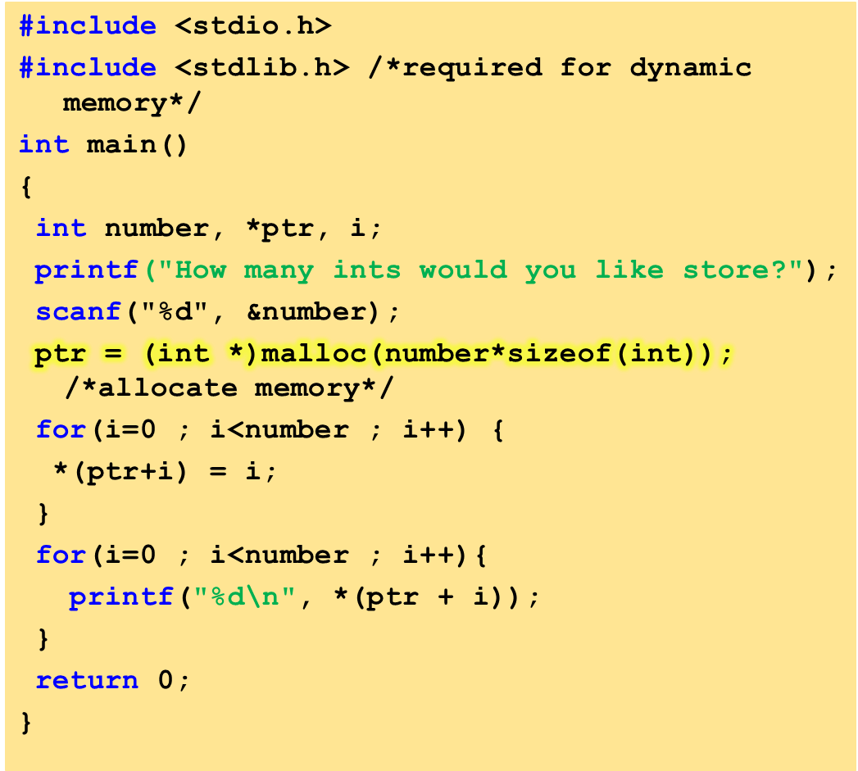
Program to allocate memory to integers.

Slide 9
How many ints would you like store? 3
0
1
2

Slide 10
calloc()
The name calloc stands for "contiguous allocation".
It provides access to memory, which is available for dynamic allocation of variable-sized blocks of memory.
Syntax:
void *calloc(size_t nitems, size_t size);
calloc is similar to malloc, but the main difference is that the values stored in the allocated memory space is zero by default. With malloc, the allocated memory could have any garbage value.
calloc() requires two arguments.
  The first is the number of variables you'd like to allocate memory for.
  The second is the size of each variable.

Slide 11
calloc()
If memory is allocated successfully, function calloc()returns a pointer to the first location of newly allocated block of memory otherwise returns NULL
Memory allocated by calloc() by default contains the zero values.
E.g. If we want to allocate memory for storing n integer numbers in contiguous memory locations
int *p;
p=(int*)calloc(n, sizeof(int));

Slide 12
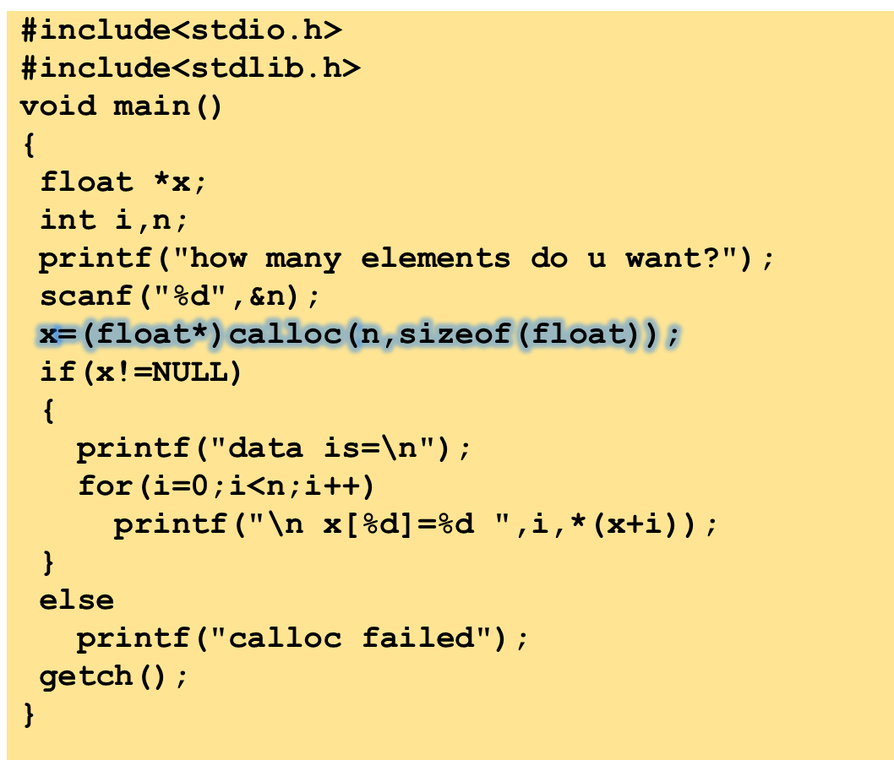
Program to show calloc() function

Slide 13
how many elements do u want 3
x[0]=0
x[1]=0
x[2]=0

Slide 14
Difference between malloc() and calloc()
 | calloc() | malloc()
Function: | Allocates a region of memory large enough to hold "n elements" of "size" bytes each. | Allocates "size" bytes of memory.
Syntax: | void *calloc (number_of_blocks, size_in_bytes); | void *malloc (size_in_bytes);
No. of arguments: | 2 | 1
Contents of allocated memory: | The allocated region is initialized to zero. | The contents of allocated memory are not changed. i.e., the memory contains garbage values.
Return value: | void pointer (void *). If the allocation succeeds, a pointer to the block of memory is returned. | void pointer (void *). If the allocation succeeds, a pointer to the block of memory is returned.

Slide 16
realloc()
Now suppose you've allocated a certain number of bytes for an array but later find that you want to add values to it. You could copy everything into a larger array, which is inefficient, or you can allocate more bytes using realloc(), without losing your data.
realloc() takes two arguments.
  The first is the pointer referencing the memory.
  The second is the total number of bytes you want to reallocate.
Passing zero as the second argument is the equivalent of calling free.
Syntax:
void *realloc(pointerToObject, newsize);

Slide 17
realloc()
If memory is allocated successfully, function realloc()returns a pointer to the first location of newly allocated block of memory which may be at same site or at new site and copy the contents from previous location to a new location if required , otherwise returns NULL.

Slide 18
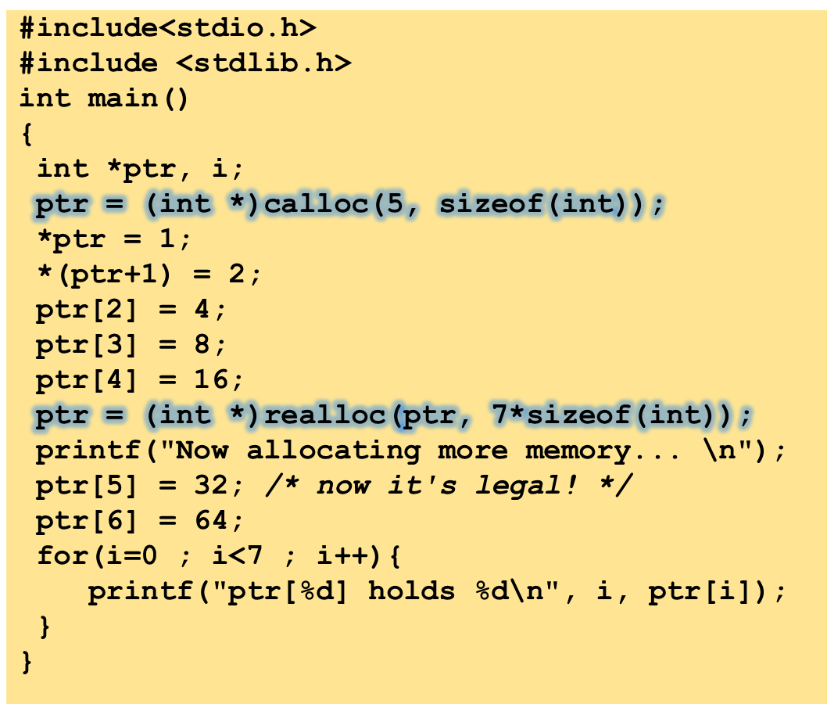
This example uses calloc to allocate memory then realloc

Slide 19
Now allocating more memory...
ptr[0] holds 1
ptr[1] holds 2
ptr[2] holds 4
ptr[3] holds 8
ptr[4] holds 16
ptr[5] holds 32
ptr[6] holds 64

Slide 20
free()
Deallocates a memory block allocated by previous call to malloc(), calloc() or realloc() and return it to memory to be used for other purposes.
Syntax:
void *free(void *block);
The argument of function free() is the pointer to block of memory which is to be freed.

Slide 21
free()
The realloc() function can behave the same as free() function provided the second argument passed to realloc() is 0.
free(ptr);
which is equivalent to
realloc(ptr,0);

Slide 22
Memory Leak
A condition caused by a program that does not free up the extra memory it allocates.
It occurs when the dynamically allocated memory is no longer needed but it is not freed.
If we continuously keep on allocating the memory without freeing it for reuse, the entire heap storage will be exhausted.
In such circumstances, the memory allocation functions will start failing and program will start behaving unexpectedly

Slide 23
Next Class: Derived Types

